Slide 1
Graphic Design Live Project
BY MOHIT MANASARA

Slide 2
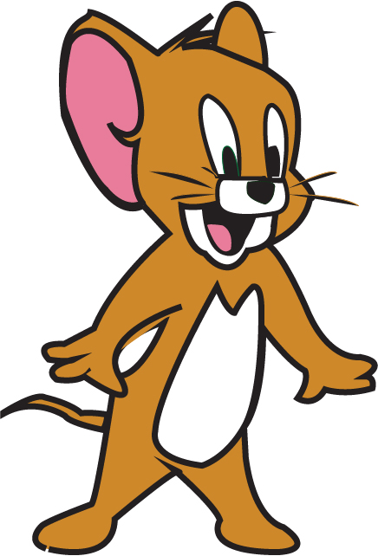
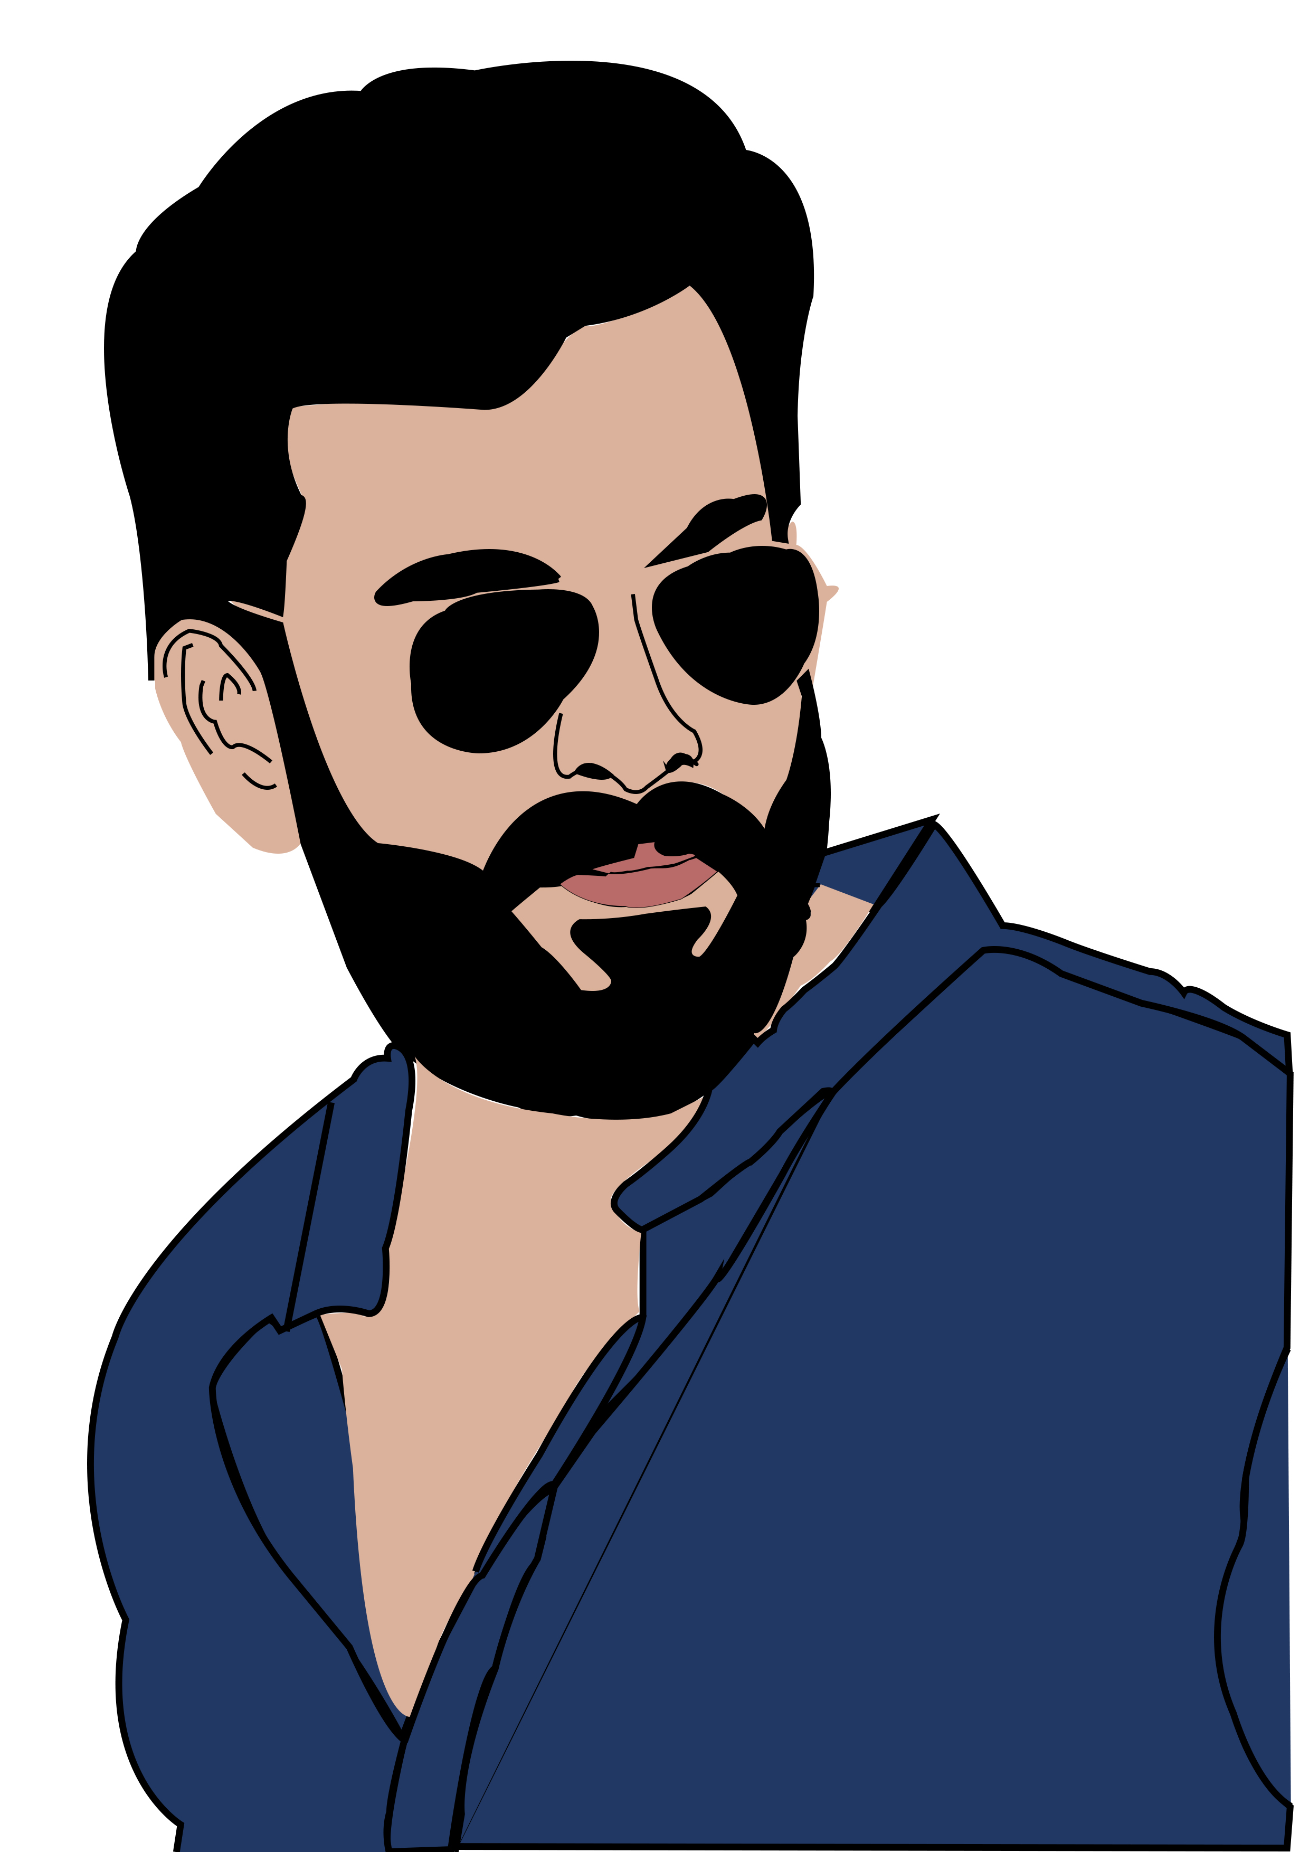

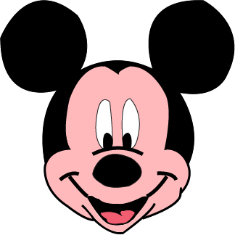
Pen tool illustration

Slide 3
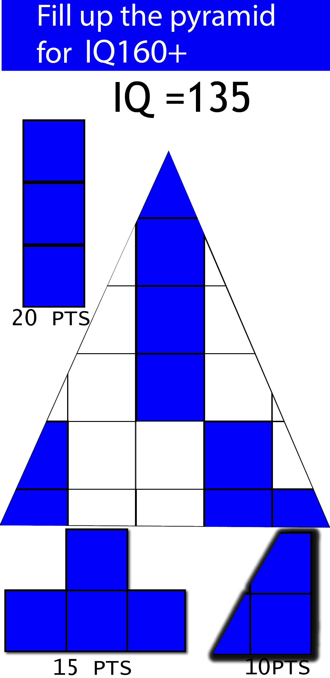
GAME DESIGN

Slide 4

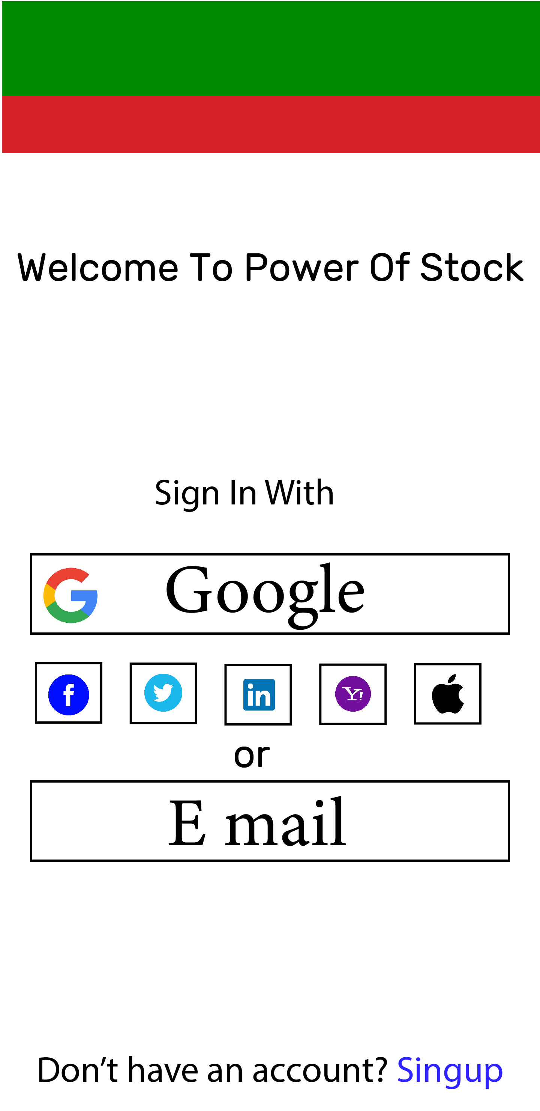
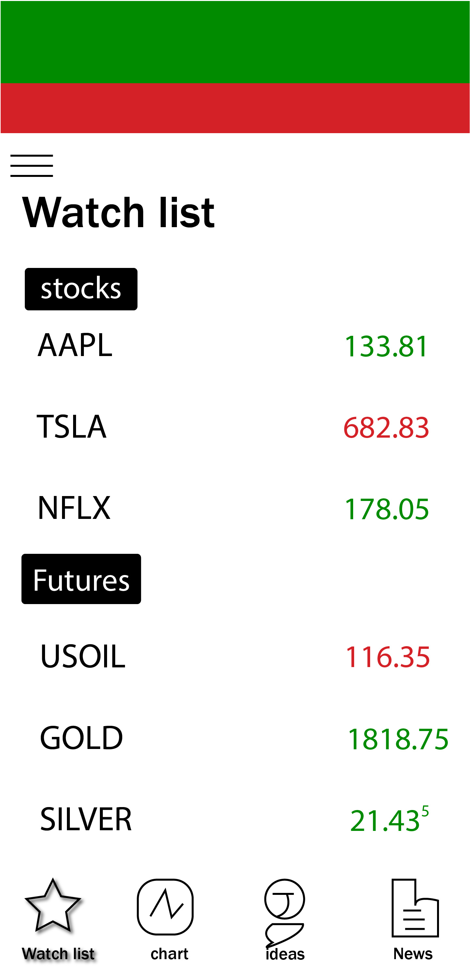
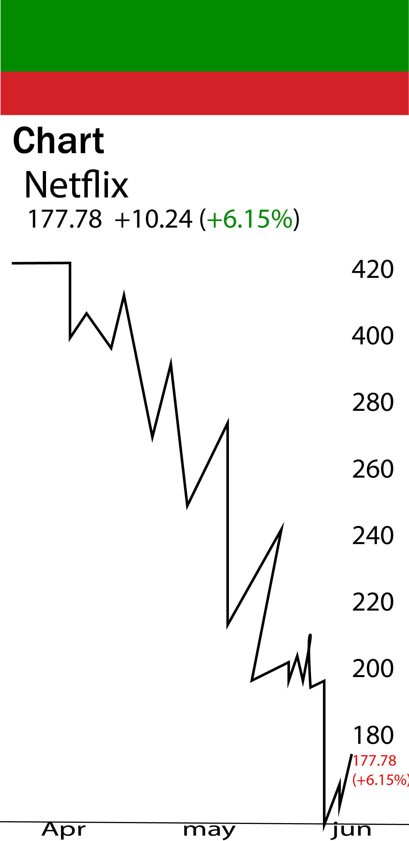
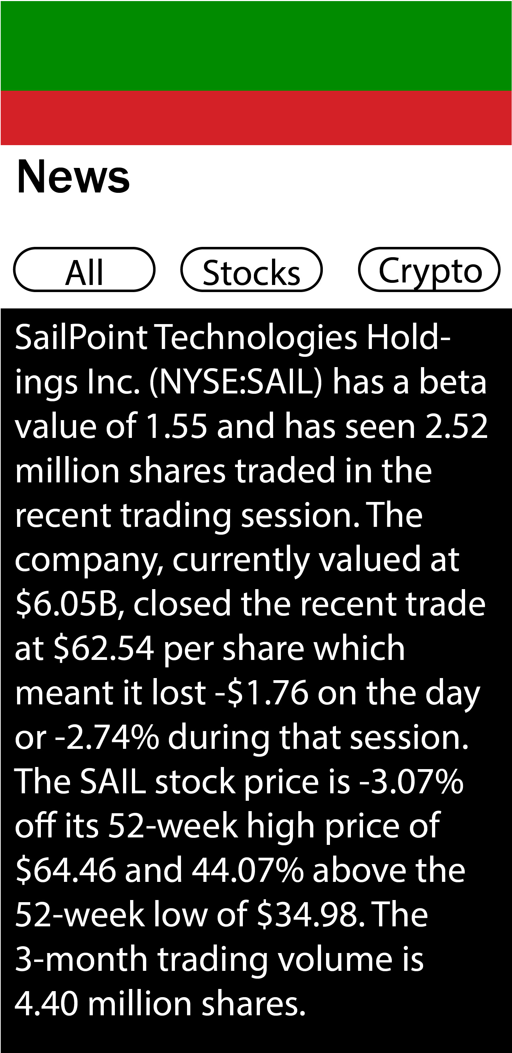
APP DESIGN

Slide 5

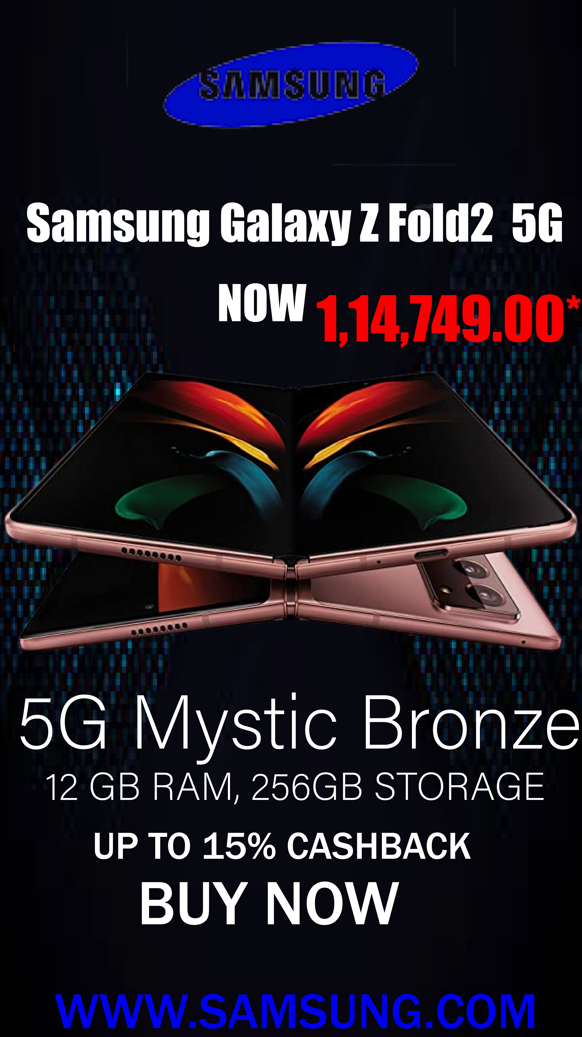

CORPORATE REEL DESIGN

Slide 6




GOOGLE ADS DESIGN

Slide 7
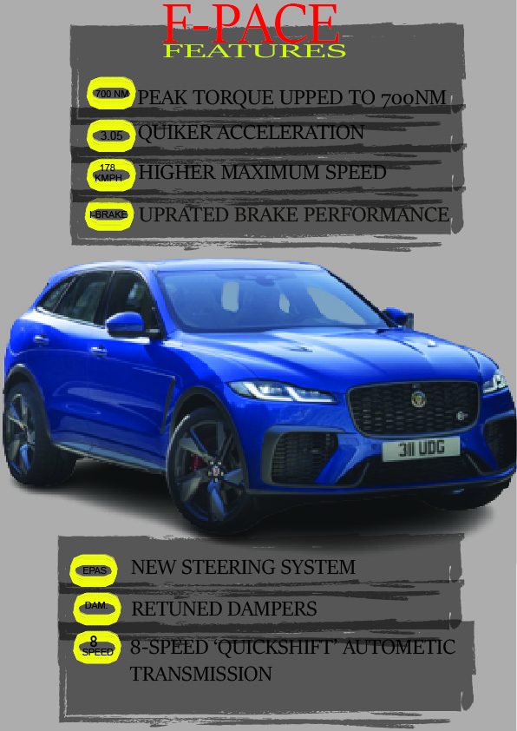
INFOGRAPHIC MAPS DESIGN

Slide 8

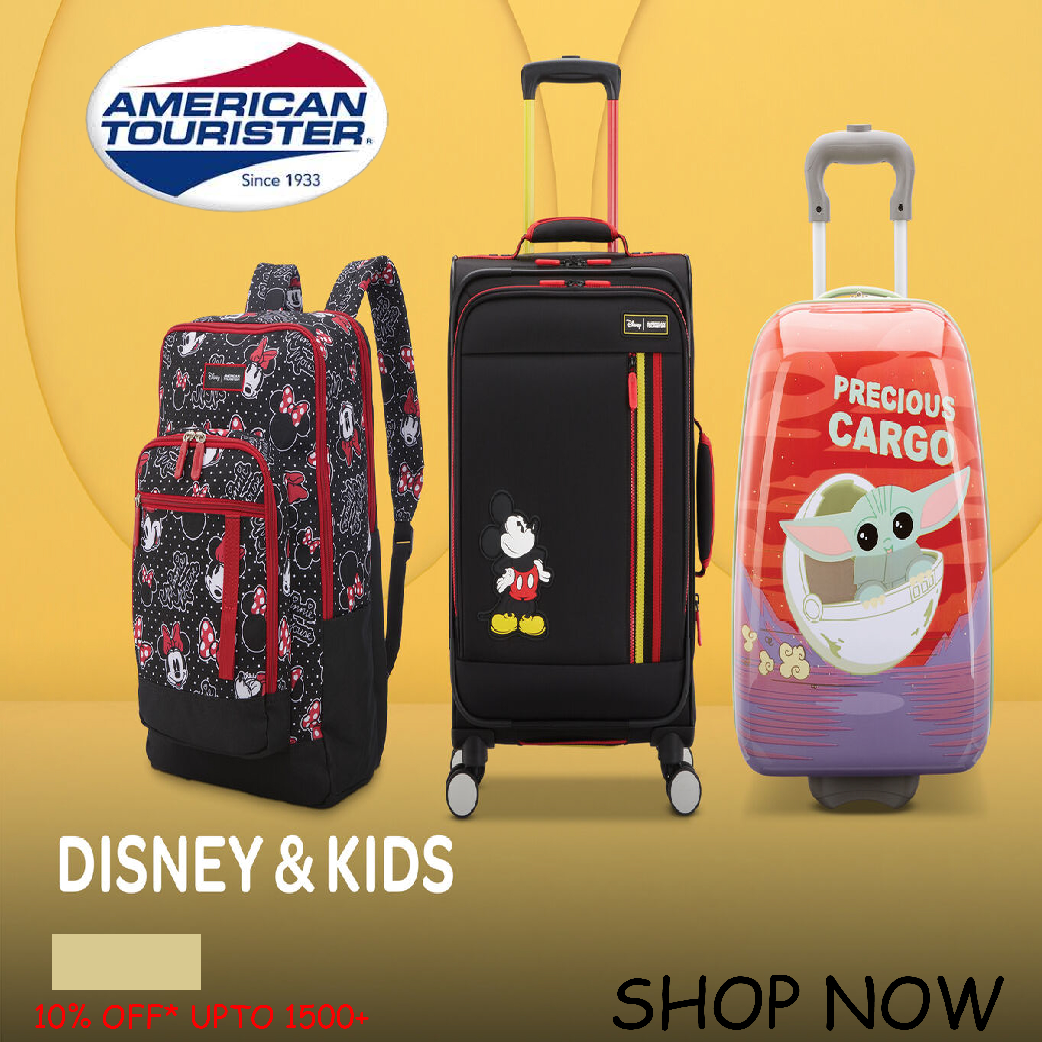

FACBOOK CRAUSER DESIGN

Slide 9
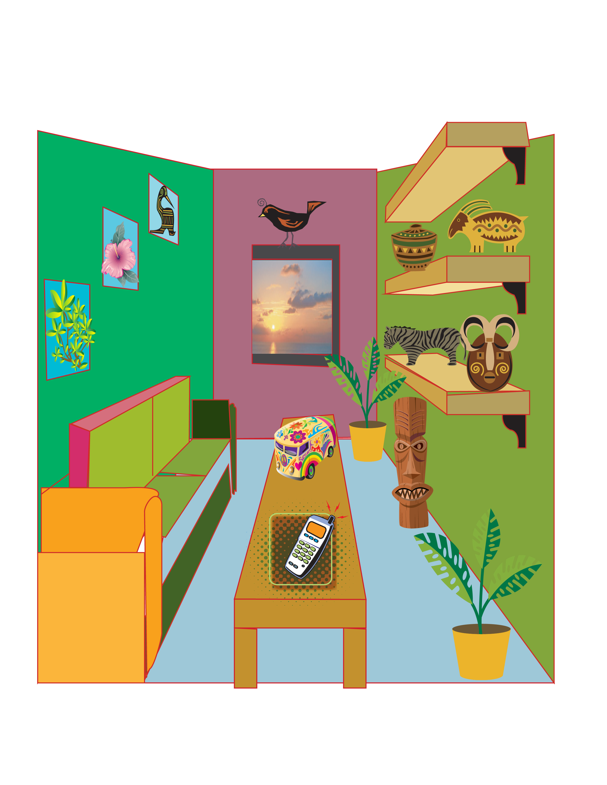
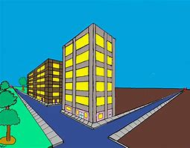

PRESPECTIVE

Slide 10


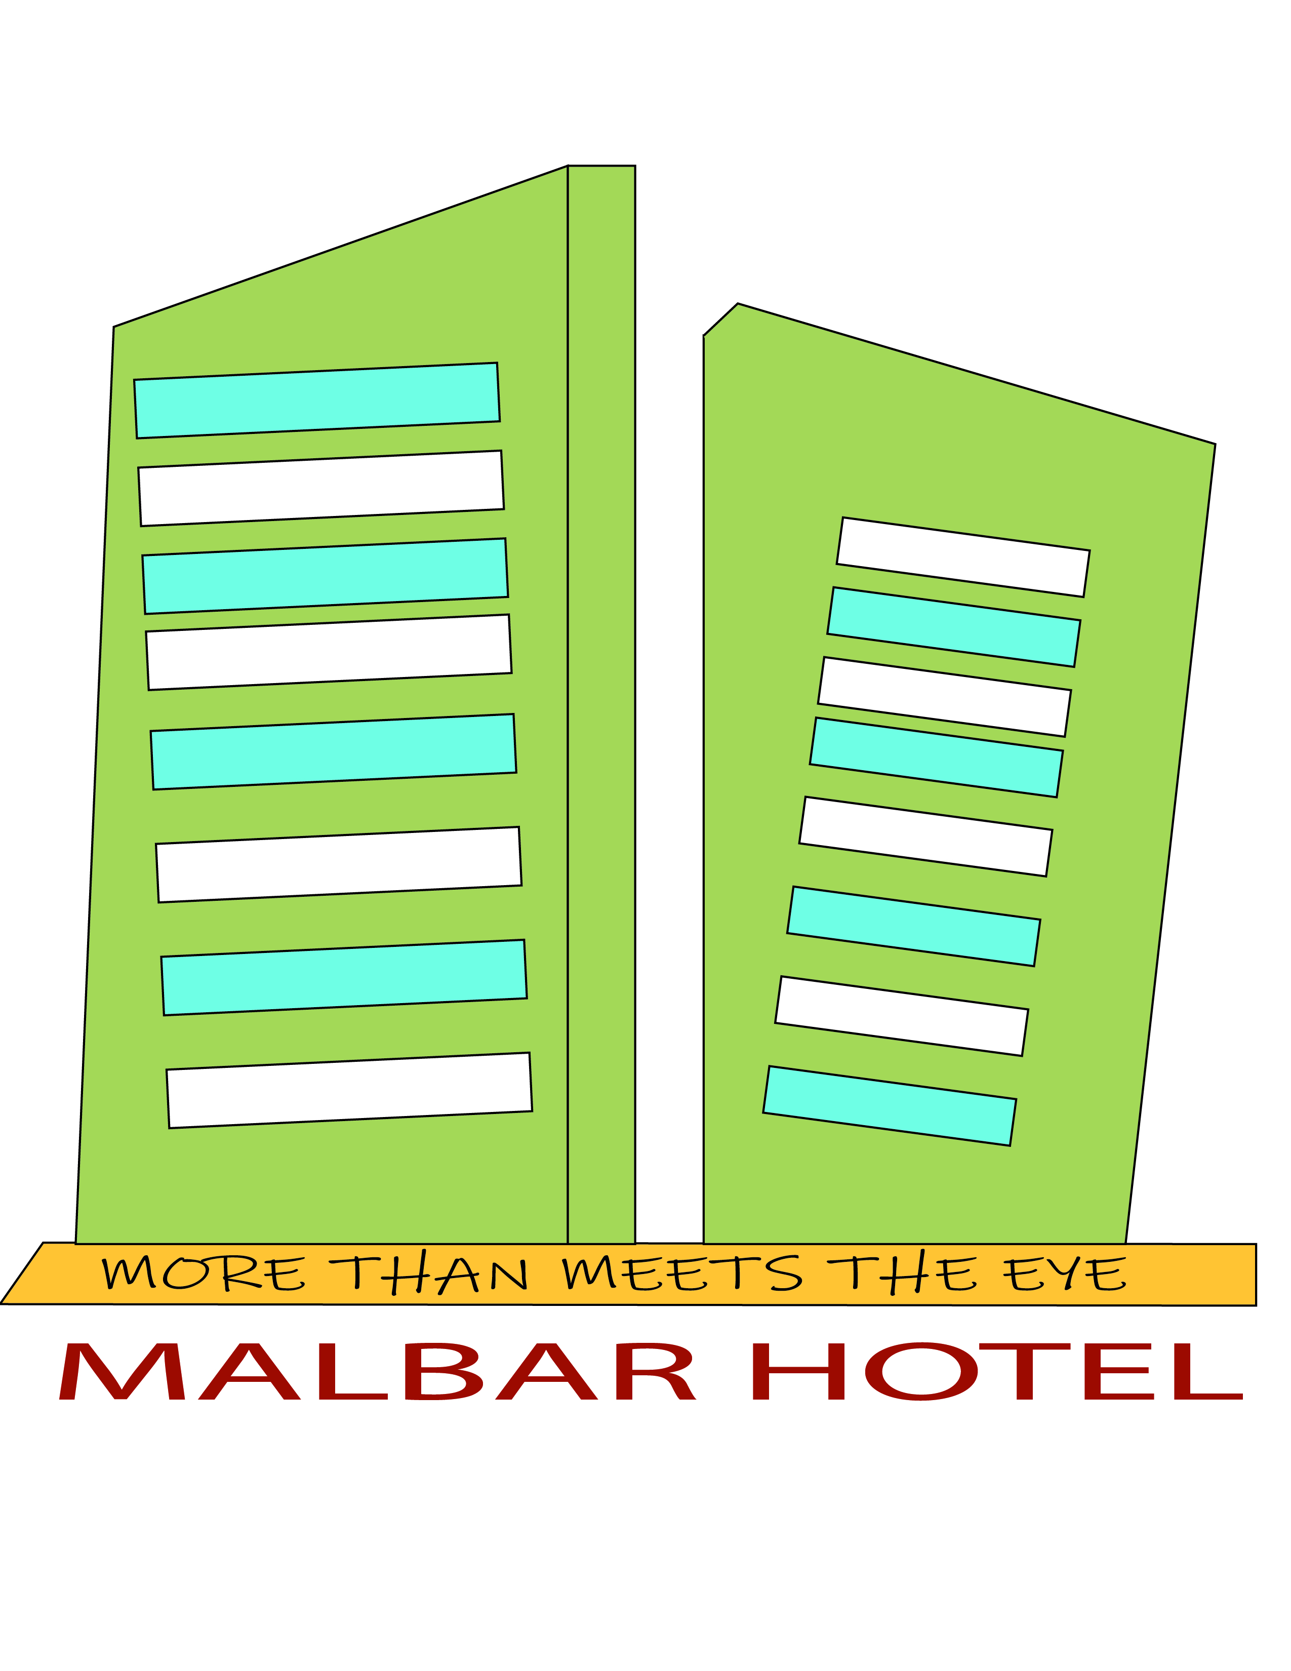

LOGO DESIGN

Slide 11




LOGO DESIGN

Slide 12




LOGO DESIGN

Slide 13




LOGO DESIGN

Slide 14




LOGO DESIGN

Slide 15
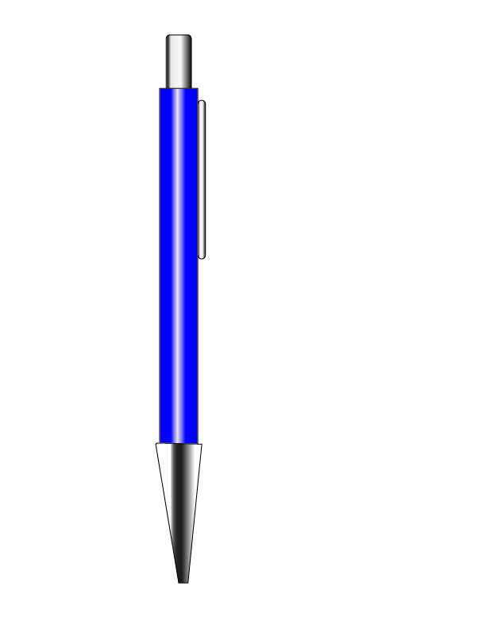
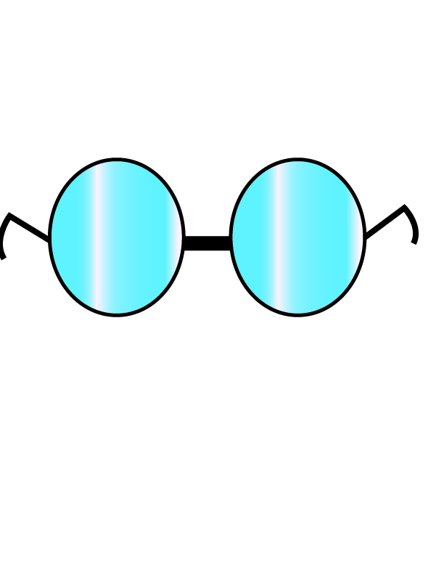
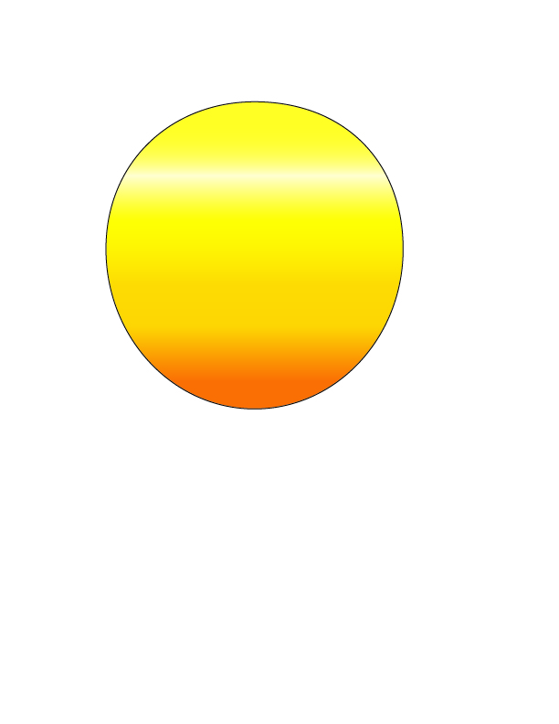
GRADIANT

Slide 16
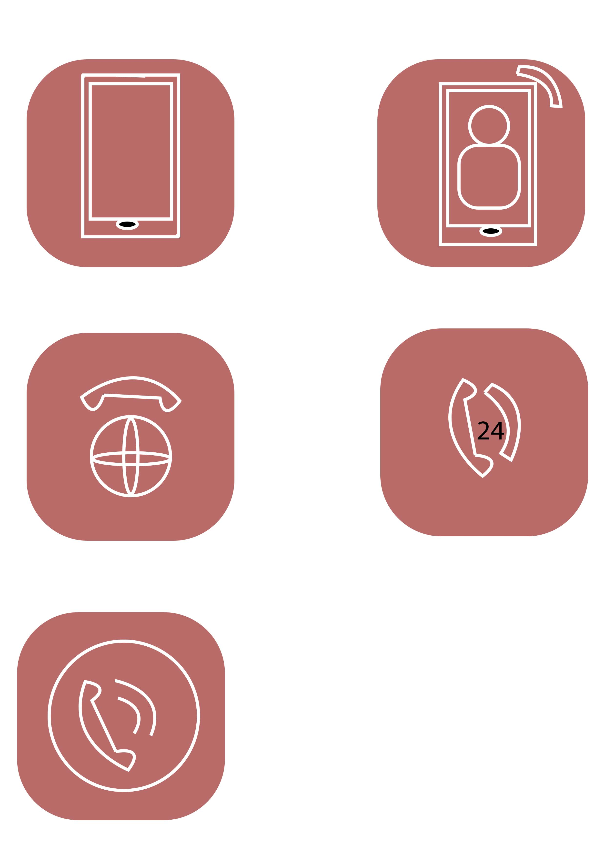
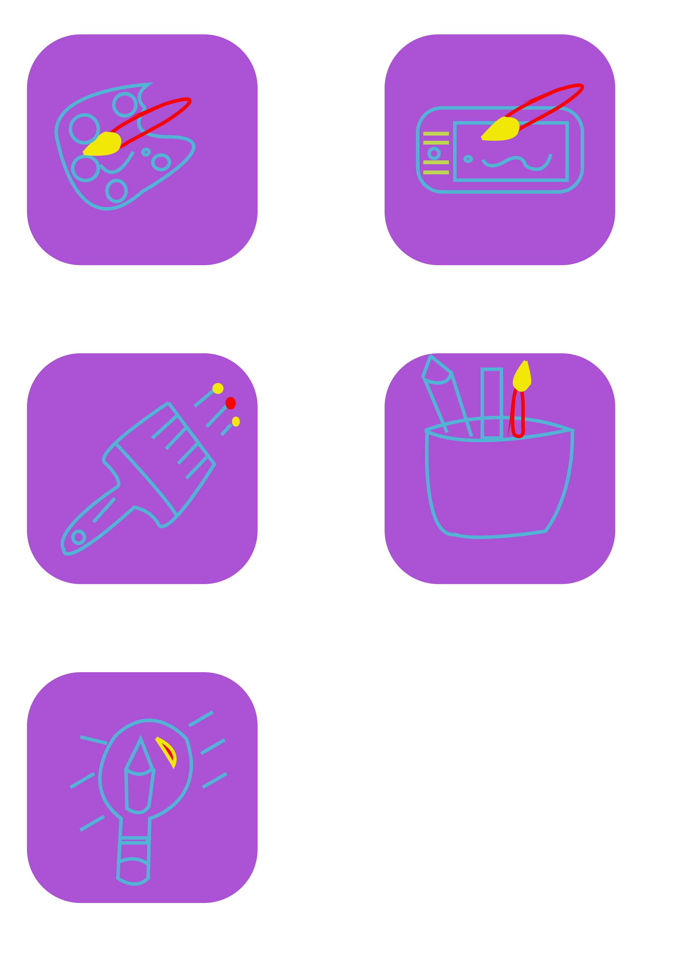
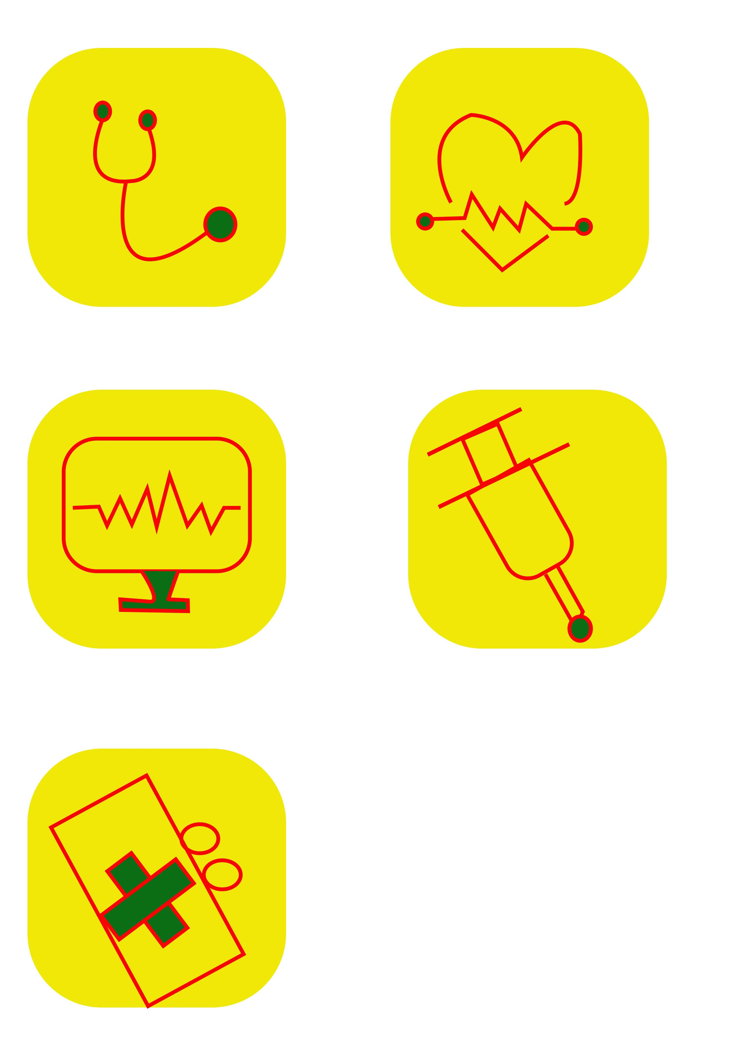
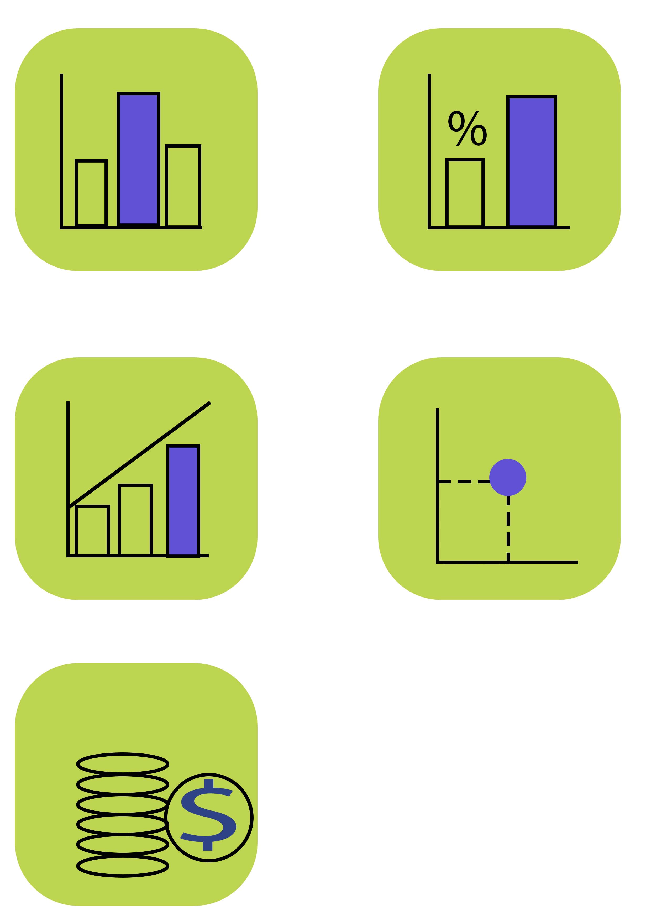

ICON DESIGN

Slide 17



typography

Slide 18
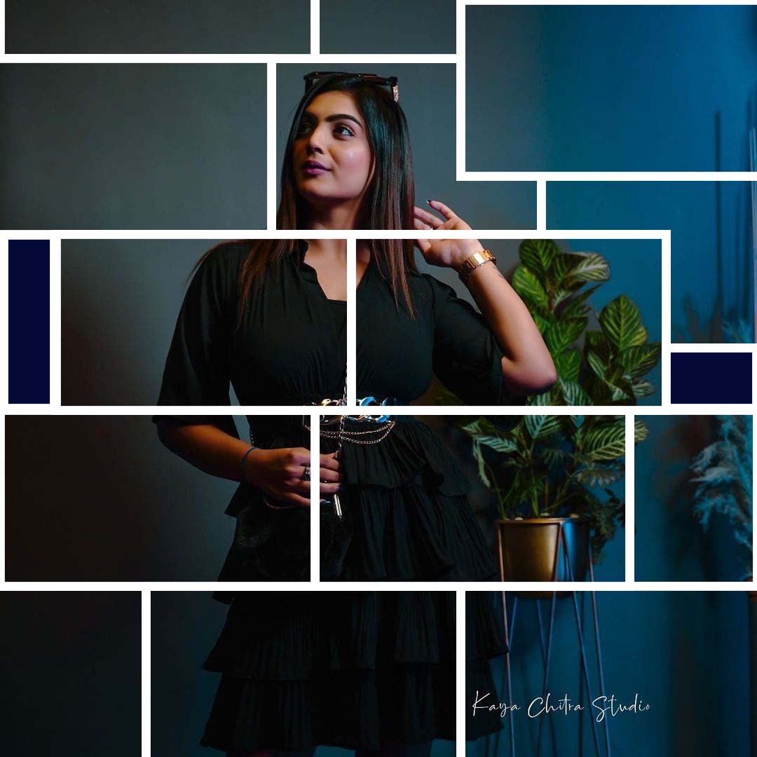
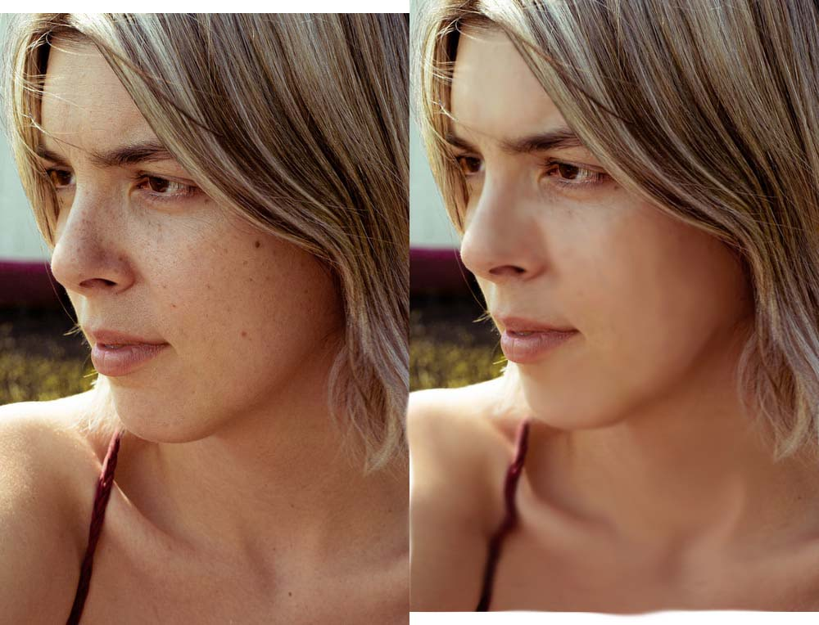
SMOOTH TOOL
CLIPIING MASK

Slide 19
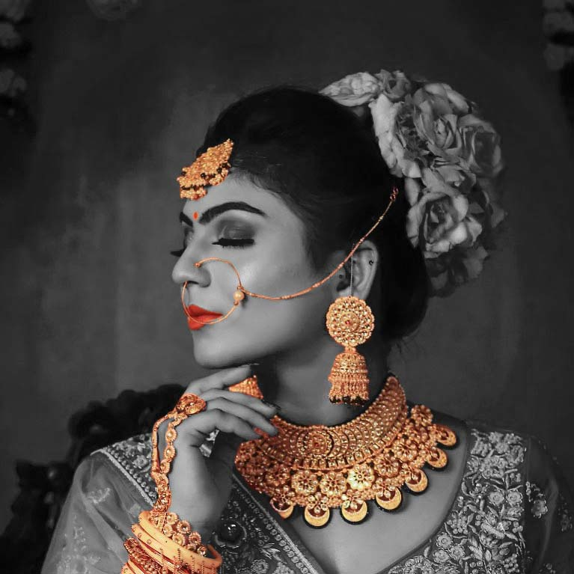
Sponge tool
JAWELLARY ADS

Slide 20
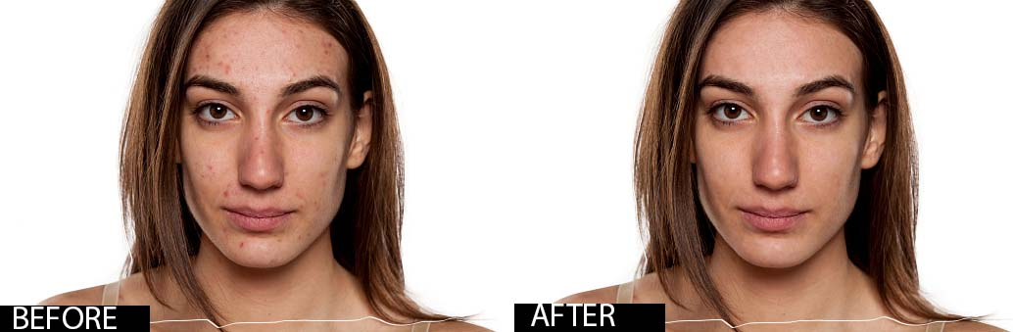
BLACK SPOT TOOL

Slide 21
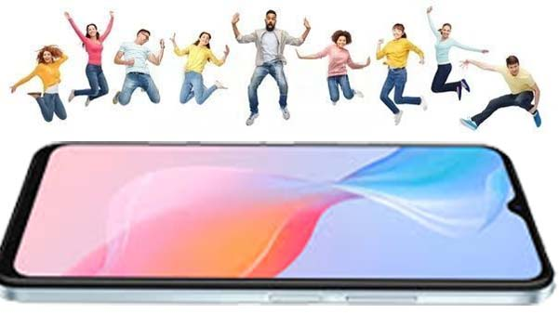
IMAGE MANUPILATION

Slide 22
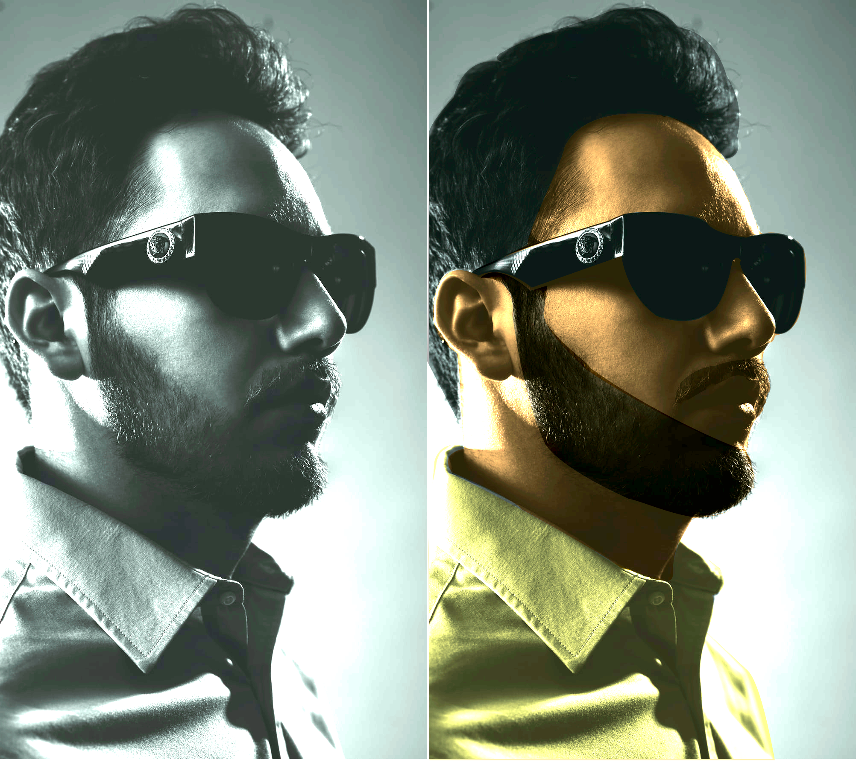
BLACK AND WHITE TO COLOUR IMAGE

Slide 23
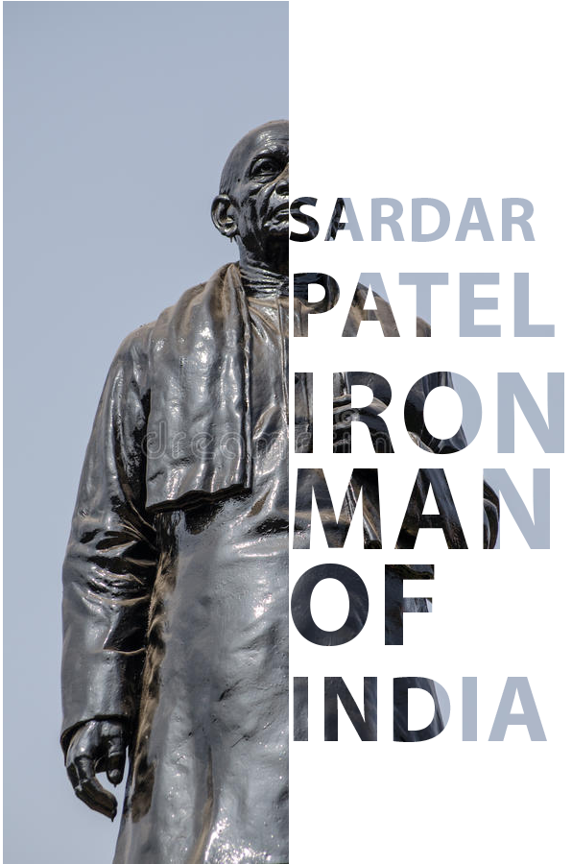
TYPOGRAPHY

Slide 24
THANK YOU

